Slide 1
OOP & data struct 5. Polymorphism & abstraction
By Somsin Thongkrairat

Slide 2
Polymorphism
- override function
- default parameter

Slide 3
Back to constructor
anime(){
cout << "this is default constructor" << endl;
playing_episode = 1;
playing_sec = 0;
}
anime(string _name,string _author,int _ep,int length){ // 4 parameter function
cout << "this is constructor for " << _name << endl;
full_name = _name;
author = author;
total_episode = _ep;
length_per_episode = length;
playing_episode = 1;
playing_sec = 0;
}
5_1_Class_constructor

Slide 4
How compiler select constructor
anime a1("The Melancholy of Haruhi Suzumiya","Nagaru Tanigawa",24,1200);
anime a2;
a2.full_name = "Spy x Family Part 1";
a2.author = "Tatsuya Endo";
a2.total_episode = 12;
a2.length_per_episode = 1440;
Yes! a1 has 4 parameter (string,string,int,int)
a2 has 0 parameter (default constructor)
this constructor is morphing!

Slide 5
What about normal function (C)
int multiply_int_int(int a,int b){
int c = a * b;
return c;
}
float multiply_int_float(int a,float b){
float c = a * b;
return c;
}
float multiply_float_int(float a,int b){
float c = a * b;
return c;
}
- compile ผ่าน
5_2_about_c_compiler

Slide 6
How about this (in C)
int multiply(int a,int b){
int c = a * b;
return c;
}
float multiply(int a,float b){
float c = a * b;
return c;
}
float multiply(float a,int b){
float c = a * b;
return c;
}
conflicting types for 'multiply’
- compile error
- same name function (C)
- function ชื่อซ้ำกัน (C)
Interesting Question is / คำถามคือ
are these all the same function?
ทั้งหมดนี้คือฟังก์ชันเดียวกันหรือไม่?

Slide 7
are these all the same function?
ทั้งหมดนี้คือฟังก์ชันเดียวกันหรือไม่?
int multiply(int a,int b){
int c = a * b;
return c;
}
float multiply(int a,float b){
float c = a * b;
return c;
}
float multiply(float a,int b){
float c = a * b;
return c;
}
In the terms of purpose : Yes
ในแง่ของจุดประสงค์การใช้งาน : ใช่
In the terms of mechanism : Not at all!
ในแง่ของหลักการทำงาน : ไม่มีทางแน่นอน!

Slide 8
Overloading function
int multiply(int a,int b){
int c = a * b;
std::cout << "multiply(int,int) : ";
return c;
}
float multiply(int a,float b){
float c = a * b;
std::cout << "multiply(int,float) : ";
return c;
}
float multiply(float a,int b){
float c = a * b;
std::cout << "multiply(float,int) : ";
return c;
}
- same name function but difference parameter can be defined as difference function
- ฟังก์ชันที่มีชื่อหมือนกันแต่รับ parameter ไม่เหมือนกันสามารถมองเป็นคนละฟังก์ชันได้
5_3_overiding_function

Slide 9
Selection function by parameter
int multiply(int a,int b){
int c = a * b;
std::cout << "multiply(int,int) : ";
return c;
}
float multiply(int a,float b){
float c = a * b;
std::cout << "multiply(int,float) : ";
return c;
}
float multiply(float a,int b){
float c = a * b;
std::cout << "multiply(float,int) : ";
return c;
}
printf("%d\n", multiply_int_int(2,1) );
printf("%f\n", multiply_int_float(2,2.0) );
printf("%f\n", multiply_float_int(2.0,3.0) );
std::cout << multiply(2,4) << std::endl;
std::cout << multiply(2,5.0F) << std::endl;
std::cout << multiply(2.0F,6) << std::endl;
Result :
2
4.000000
6.000000
multiply(int,int) : 8
multiply(int,float) : 10
multiply(float,int) : 12

Slide 10
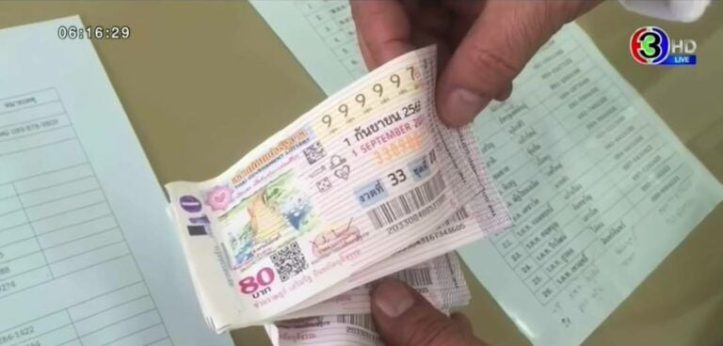
No except for method in class
class lotto{
string winner_number;
public :
void random_number(){ // real psudo random
winner_number[0] = (rand()%10) + '0';
winner_number[1] = (rand()%10) + '0';
winner_number[2] = (rand()%10) + '0';
winner_number[3] = (rand()%10) + '0';
winner_number[4] = (rand()%10) + '0';
winner_number[5] = (rand()%10) + '0';
}
void print(){
cout << "winner price is " << winner_number << endl;
}
lotto(){
winner_number = "000000";
}
};
Code :
lotto a;
a.random_number();
a.print();
Result :
winner price is 882455
5_4_lotto.cpp

Slide 11
void random_number(int fifth_digit, int sixth_digit){ // lock 2 digit random
winner_number[0] = (rand()%10) + '0';
winner_number[1] = (rand()%10) + '0';
winner_number[2] = (rand()%10) + '0';
winner_number[3] = (rand()%10) + '0';
winner_number[4] = (rand()%10) + '0';
winner_number[5] = (rand()%10) + '0';
if(fifth_digit >= 0) winner_number[4] = fifth_digit + '0';
if(sixth_digit >= 0) winner_number[5] = sixth_digit + '0';
}
void random_number(int forth_digit, int fifth_digit, int sixth_digit){ // lock 3 digit random
winner_number[0] = (rand()%10) + '0';
winner_number[1] = (rand()%10) + '0';
winner_number[2] = (rand()%10) + '0';
winner_number[3] = (rand()%10) + '0';
winner_number[4] = (rand()%10) + '0';
winner_number[5] = (rand()%10) + '0';
if(forth_digit >= 0) winner_number[3] = forth_digit + '0';
if(fifth_digit >= 0) winner_number[4] = fifth_digit + '0';
if(sixth_digit >= 0) winner_number[5] = sixth_digit + '0';
}

Slide 12
Overloading method
Result :
winner price is 174094
winner price is 882455
winner price is 171155
winner price is 761455
winner price is 221666
winner price is 761666
lotto a;
a.random_number();
a.print();
a.random_number();
a.print();
a.random_number(5,5);
a.print();
a.random_number(5,5);
a.print();
a.random_number(6,6,6);
a.print();
a.random_number(6,6,6);
a.print();

Slide 13
Overload can call another overload inside
void random_number(int fifth_digit, int sixth_digit){ // lock 2 digit random
random_number();
if(fifth_digit >= 0) winner_number[4] = fifth_digit + '0';
if(sixth_digit >= 0) winner_number[5] = sixth_digit + '0';
}
void random_number(int forth_digit, int fifth_digit, int sixth_digit){ // lock 3 digit random
random_number();
if(forth_digit >= 0) winner_number[3] = forth_digit + '0';
if(fifth_digit >= 0) winner_number[4] = fifth_digit + '0';
if(sixth_digit >= 0) winner_number[5] = sixth_digit + '0';
}

Slide 14
void random_number(int fifth_digit, int sixth_digit){ // lock 2 digit random
random_number();
if(fifth_digit >= 0) winner_number[4] = fifth_digit + '0';
if(sixth_digit >= 0) winner_number[5] = sixth_digit + '0';
}
void random_number(int forth_digit, int fifth_digit){ // lock 3 digit random
random_number();
if(forth_digit >= 0) winner_number[3] = forth_digit + '0';
if(fifth_digit >= 0) winner_number[4] = fifth_digit + '0';
if(sixth_digit >= 0) winner_number[5] = sixth_digit + '0';
}
void lotto::random_number(int, int)' cannot be overloaded with 'void lotto::random_number(int, int)'
Cannot overload same type parameter method
ไม่สามารถ overload ฟังก์ชันที่มี parameter เหมือนกันได้

Slide 15
Default parameter & Default initialization
class calculator{
float result;
public :
void print(){
cout << "the result is " << result << endl;
}
};
How to initial value of result
เราสามารถกำหนดค่าเริ่มต้นของ result ได้ด้วยวิธีได้บ้าง
5_5_calculator_class

Slide 16
Default initialization
- constructor
- assigned when declarated
- C++ Initializer (advance)
Same result / ผลลัพธ์เหมือนกัน

Slide 17
Default initialization
class calculator{
//float result = 0;
float result {0};
public :
calculator(){
result = 0;
}
void print(){
cout << "the result is " << result << endl;
}
};
assigned when declarated
C++ Initializer
constructor
Result :
the result is 0

Slide 18
Default parameter
void sum(float a,float b){
result = a+b;
}
void sum(float a,float b,float c){
result = a+b+c;
}
void sum(float a,float b,float c,float d){
result = a+b+c+d;
}
Consider these method / พิจารณา 3 method นี้
calculator c;
c.sum(11,12,13);
c.print();
c.sum(11,12,13,0);
c.print();
Exact same result or not?
ให้ผลลัพธ์เหมือนกันหรือไม่?
Yes Result :
the result is 36
the result is 36

Slide 19
Default parameter
void sum(float a,float b,float c,float d = 0){
result = a+b+c+d;
}
2 way to call this method
มี 2 วิธีทีจะเรียกใช้ method นี้
sum(float,float,float,float);
sum(float,float,float);
void sum(float a,float b,float c,float d){
result = a+b+c+d;
}
void sum(float a,float b,float c){
d = 0;
result = a+b+c+d;
}
Same as original
Assign d to default (zero)

Slide 20
void sum(float a,float b,float c,float d = 0){
result = a+b+c+d;
}
void sum(11,12,13,0){
result = 11+12+13+0;
}
calculator c;
c.sum(11,12,13);
c.print();
c.sum(11,12,13,14);
c.print();
Result :
the result is 36
the result is 50
void sum(11,12,13,14){
result = 11+12+13+14;
}

Slide 21
Default parameter
- Generate method or function for all possible default parameter
- สร้าง function หรือ method ตาความเป็นไปได้ทั้งหมดของ default parameter
void sum(float a,float b = 1,float c = 0,float d = 0){
result = a+b+c+d;
}
Generate these method :
void sum(float,float,float,float);
void sum(float,float,float);
void sum(float,float);
void sum(float);

Slide 22
void sum(float a,float b = 1,float c = 0,float d = 0){
result = a+b+c+d;
}
void sum(float,float,float,float);
void sum(float,float,float);
void sum(float,float);
void sum(float);
void sum(float,float,float,float);
void sum(float,float,float,0);
void sum(float,float,0,0);
void sum(float,1,0,0);

Slide 23
Warning redundant with origin method
void sum(float a,float b,float c){
result = a+b+c;
}
void sum(float a,float b,float c,float d = 0){
result = a+b+c+d;
}
Error :
call of overloaded 'sum(int, int, int)' is ambiguous
*ข้อควรระวัง สามารถซ้ำกับ method เดิมได้

Slide 24
Another example
void sum(float a,float b,float c = 0,float d = 0){
result = a+b+c+d;
}
void max(float a,float b,float c = 0,float d = 0){
if(a > b && a > c && a > d) result = a;
else if(b > a && b > c && b > d) result = b;
else if(c > a && c > b && c > d) result = c;
else result = d;
}
calculator c;
c.sum(11,12);
c.print();
c.sum(11,12,13);
c.print();
c.sum(11,12,13,14);
c.print();
c.max(11,12,13,14);
c.print();
c.max(11,12,13);
c.print();
c.max(11,12);
c.print();
Result :
the result is 23
the result is 36
the result is 50
the result is 14
the result is 13
the result is 12

Slide 25
Quiz

Slide 26
Abstract class (Abstraction)
- a class that designed to inherit and point to another object only, cannot create any object
- create by create at less one pure virtual function in class
- เป็น class ที่ออกแบบมาเพื่อการสืบทอด (inherit) และชี้ไปยัง object อื่น เท่านั้นไม่สามารถสร้าง object จาก class นี้ได้
- สร้างได้โดยการสร้าง pure virtual function อย่างน้อยหนึ่งฟังก์ชันใน class

Slide 27
Pure virtual function
- a function that have only declaration and no need to write definition
- ฟังก์ชันที่มีเพียงแค่ declaration ไม่ต้องสร้างในส่วนของ definition

Slide 28
Pure virtual function syntax
- assign a declaration of function to zero
- กำหนดส่วนของ declaration ให้เท่ากับศูนย์
class creature{
public :
string name;
int x = 0;
virtual void move(int _x) = 0;
};
5_6_pure_virtual_function

Slide 29
class creature{
public :
string name;
int x = 0;
virtual void move(int _x) = 0;
};
Creature is now abstract class
ตอนนี้ class creature กลายเป็น abstract แล้ว
creature alien;
alien.name = "alien";
Error :
cannot declare variable 'alien' to be of abstract type 'creature'

Slide 30
Why we want abstract class
- we want to provide common class to be a guidelines creating child class
- provide a hierarchy paradigm or rule to develop same project
- provide common class to assigned to be any object in the project
- etc.
- เพื่อเป็นแนวทางเดียวกันในการพัฒนา class ลูกที่อยู่ต่ำกว่า
- เพื่อกำหนดแนวทางหรือกฎของการพัฒนาเป็นลำดับชั้น
- เพื่อสร้าง class กลางที่สามารถกำหนดให้เป็น object ได้ก็ได้ในระบบ
- อื่นๆ

Slide 31
Another example
class vehicle{
protected :
int speed;
int wheel_count;
vehicle(int wheel){
wheel_count = wheel;
}
public :
void print_wheel(){
cout << "this vehicle has [" << wheel_count << "] Wheel(s)" << endl;
}
void virtual print() = 0;
};
5_7_vehicle_abstract

Slide 32
Another example
- all class that inherited from vehicle class must implement print() function to be usable class
- ทุก class ที่สืบทอดไปจาก class vehicle ต้อง implement ฟังก์ชัน print() เพื่อให้กลายเป็น class ที่สามารถสร้าง object ได้

Slide 33
motorbike vaspa_sprint;
airplane a380(22);
airplane a777(14);
submarine S26T;
vehicle* my_vehicles[4];
my_vehicles[0] = &vaspa_sprint;
my_vehicles[1] = &a380;
my_vehicles[2] = &a777;
my_vehicles[3] = &S26T;
for(int i=0;i<4;i++){
my_vehicles[i]->print();
}
Result :
motobike is using speed [98]Kph
airplane is at [0] ft above sea level using speed [0]Kph
airplane is at [0] ft above sea level using speed [0]Kph
submarine is at [0] depth level using speed [0]Kph

Slide 34
conclude
- overloading constructor & function
- default parameter & default initialization
- pure virtual function & abstract class

Slide 35
LAB

Slide 36
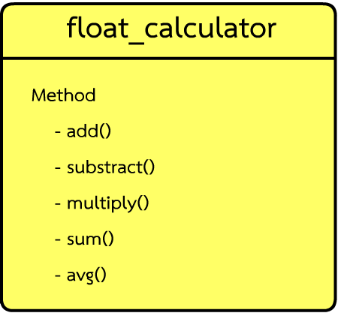
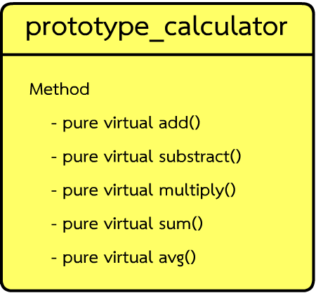
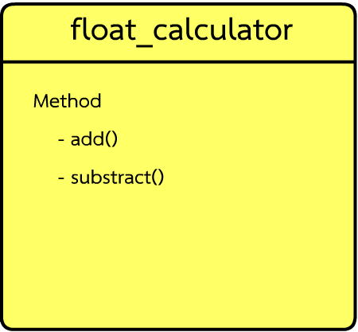
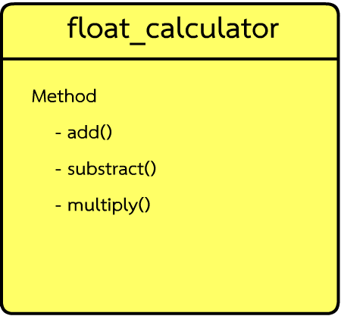

Slide 37
